Slide 1
RFC 2045: Multipurpose Internet Mail Extensions(MIME) Part 1
Sayali Ghaisas
sghaisas@usc.edu
Notes:
Slides can vary as per your presentation, but header and footer should be consistent

Slide 2
What is MIME
The Multipurpose Internet Mail Extensions is the Internet protocol that enables the transfer of various types of data over the Internet.
MIME messages can contain
Text
Images
Audio
Video
Executables and other Application specific data(like PDF files, Word documents)

Slide 3
Introduction: Request for Comments
Brief History:
An RFC is authored by engineers and computer scientists to describe methods, research and innovations applicable to working of Internet.
Invented by Steve Crocker in 1969 to help record notes on ARPANET
They have become standard for specification of Internet protocols and transfer of messages over Internet.
IETF issues Request For Comments (RFC) in the form of memorandum
From 1969-1998 Jon Postel of Information Sciences Institute, USC served as Editor for RFCs on SMTP and administered IANA.
RFCs are the official documents of Internet Specifications and Communication Protocols

Slide 4
Evolution of Protocols:
A chronology of the RFCs in development of MIME:
RFC 821- Simple Mail Transfer Protocol (SMTP)
RFC 822- Further revision with comprehensive message representation of headers and body in US-ASCII
RFC 1341- In June 1992 it was the first draft for extensions for other data types apart from US-ASCII
RFC 2045 through RFC 2049- Extensions to original email specification of RFC 822 that define MIME
RFC 2045 was written by Ned Freed and Nathaniel Borenstein of the Network Working Group in November 1996

Slide 5
MIME Extensions to overcome limitations of RFC 822
Text in character sets other than US-ASCII
Non text attachments
Multi-part message bodies
Header information in non-ASCII character sets

Slide 6
RFC 2045
Describes the Headers that are used to define the MIME messages and the types of data contained in the message body.
There are 5 header fields namely:
MIME- Version
Content-Type
Content-Transfer Encoding
Content-ID
Content Description
*1-3 are required while 4-5 are additional fields

Slide 7
Basic Terminology
CRLF: Denotes line break. Composed of 2 characters CR and LF
Character set: method of converting sequence of octets into sequence of characters. Eg: US-ASCII.
http://www.iana.org/assignments/character-sets/character-sets.xhtml
Augmented BNF Grammar: Is meta-language for RFCs. The formal definition to specify headers and messages. Simplified form by Ken L. Harrenstien.
7-bit(0-127), 8-bit(0-255), binary data: 1 line contains 998 octets.
Lines separated by CRLF.
Each message is composed of: Header fields and an optional body separated by an empty line CRLF.

Slide 8
1. MIME Version Header Field
Describes the version of the MIME message format
Declares the version of the Internet Message Body format standard in use
Presence of this header field implies that the message is in compliance with this document
The field can be included in document as follows:
MIME-Version:1.0
version:=“MIME-version” “:” 1*DIGIT”.”1*DIGIT
Originally designed for version control.

Slide 9
2. Content Type Header Field
Describes the data contained in the body of message
Media type that is MIME content type and subtype identifier
Followed by a set of parameters in the form: attribute=value
Content-Type: = type "/" subtype *[";" parameter]
Content-Type: text/plain; charset= us-ascii (default)
Content-Type: text/html; charset=UTF-8
Content-Type: multipart/form-data; boundary=something

Slide 10
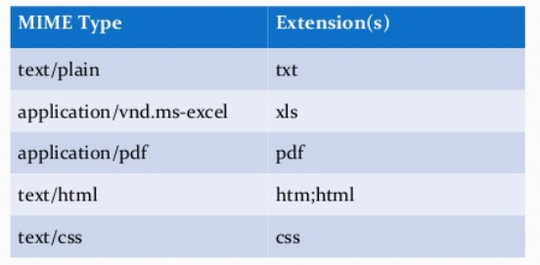
Content types and subtypes
Type=top level media type
Subtype=specific format of that type
Content/filetype (filext.com)

Slide 11
Parameters and Media Types
Parameters are modifiers of the media subtype.
Content-Type: text/plain; charset=ISO-8859-1
There are 7 top level media types divided as:
5 Discrete: Content is opaque w.r.t. MIME processors
Text- (Default) specifies text content
Image- Graphic non-moving images
Audio- Audio data
Video- Moving images
Application- Executable or binary code
2 Composite: Content requires additional MIME processing
Message- Encapsulates message defined by RFC 822
Multipart- Combines several parts of document which have different types

Slide 12
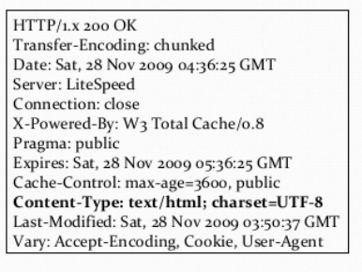
Example of HTTP Response Header:

Slide 13
3. Content Transfer Encoding Field
Binary files must be packaged as text in order to be sent over the Internet
Encoding transforms binary data into a string (octets)
Decoding changes the data back into its original form
This field specifies the mechanism used for encoding.

Slide 14
Encoding Schemes
The field’s value is a single token specifying the type of encoding used
They are not case sensitive
Formally:
Encoding := “Content-Transfer-Encoding” “:” mechanism
Mechanism := “7-bit”
“8-bit”
“binary”
“quoted-printable”
“base-64”

Slide 15
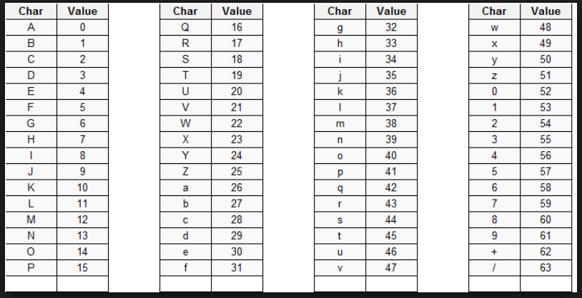
Base 64
Used for binary files.
3 bytes(24 bits) are transformed into
4 ASCII characters.
Line length limited to 76 characters.

Slide 16
Example
Normal: The quick brown fox jumps over the lazy dog
Encoded:VGhlIHF1aWNrIGJyb3duIGZveCBqdW1wcyBvdmVyIHRoZSBsYXp5IGRvZw==
Online encoder tools: https://www.base64encode.org/ ; http://www.motobit.com/util/base64-decoder-encoder.asp

Slide 17
Quoted- Printable
Used for ASCII characters.
Line length limited to 76 characters.
If longer lines are to be encoded ‘soft’ line breaks are used with = sign
Example: Now’s the time =
for all folk to come =
for aid of their country.
Tool: http://www.motobit.com/util/quoted-printable-encoder.asp

Slide 18
4. Content ID Header Field
Allows one body of information to make reference to another using the unique ID value.
Is syntactically similar to Message ID header field
id:=“Content-ID” “:” “msg-id”
Used to uniquely identify MIME entities in several contexts particularly for caching data referenced by the message/ external body mechanism

Slide 19
5. Content Description Header Field
Description for a body of information
In the form:
description:=“ Content- Description””:” *text
Description is to be given in US-ASCII character set
Additional MIME header fields must have the prefix ‘Content’

Slide 20
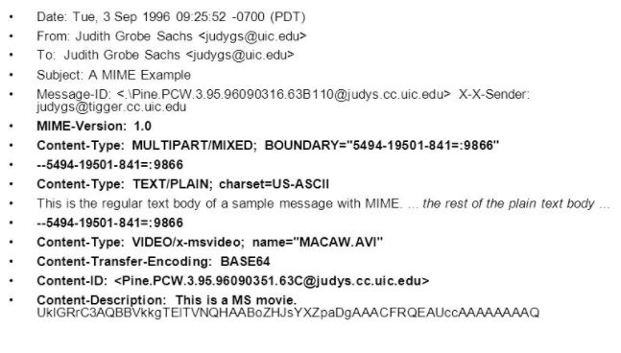
MIME Example

Slide 21
Summary
Using MIME-Header fields it is possible to include arbitrary types of data with RFC 822 conformant mail messages.
Does not violate prior RFCs and takes care to avoid problems that may occur due to different data types.
Further RFCs would explain the messages format and integration with different media types.

Slide 22
Final Remarks
Pros:
Details oriented.
Impactful which can be seen from its widespread usage and implementation.
Clear division of ideas and concepts, sub-concepts in hierarchy.
Informal discussion of ideas and concepts to generate formal standards.
Cons:
Difficult to comprehend standalone.
Draws many references to prior RFCs and protocols. Hence requires a sound understanding of these.
Simplification of concepts is a challenge.
Has fewer examples.

Slide 23
QUESTIONS

Slide 24
THANK YOU

